Slide 1
RAMADDA
Repository for Archiving and MAnaging Diverse Data
Content management system
Scientific data repository
Wiki
Visualization environment
Technology
Open source
Java based
Runs stand-alone or in a servlet container
Yada yada yada

Slide 2
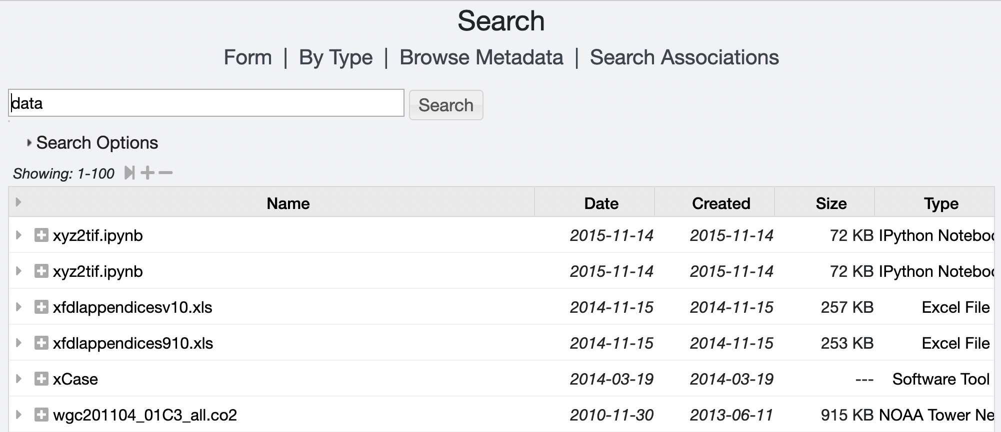
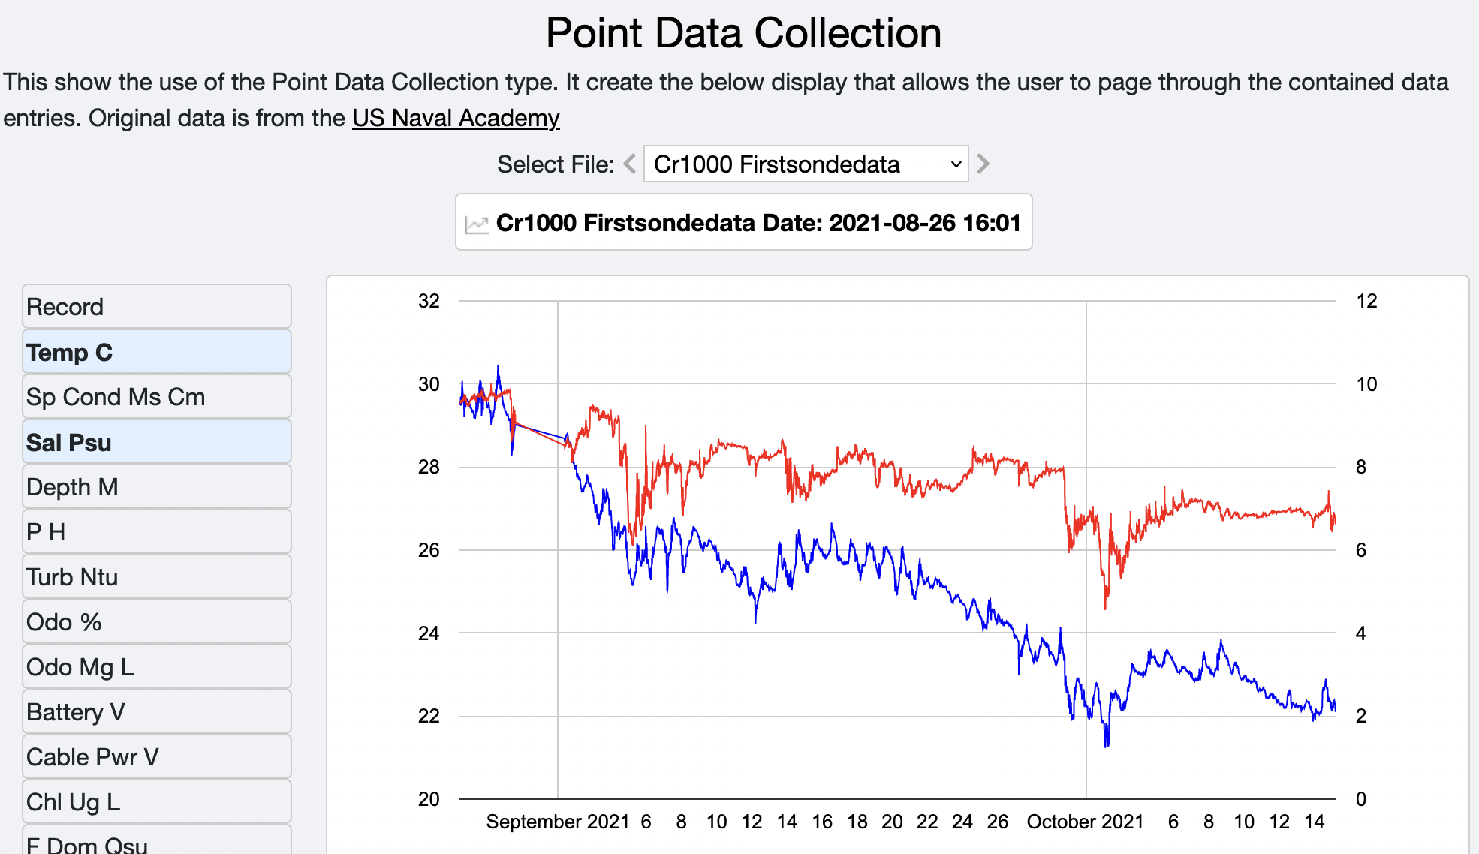
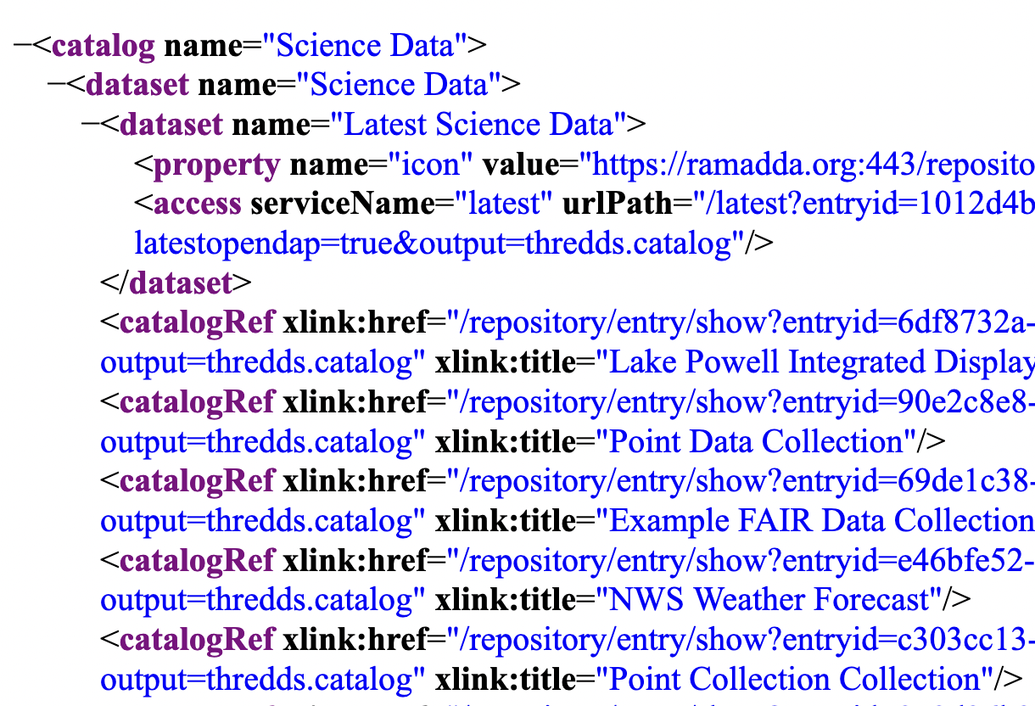
RAMADDA Model
Hierarchy of typed entries
Search
Folder
Tag
Docs
Data
Wiki text
Keyword
Displays
Wiki page
Image
Cr1000.csv
Services
RSS
Catalogs
Data
…
Alias
Thumbnail
Properties attached to entries

Slide 3
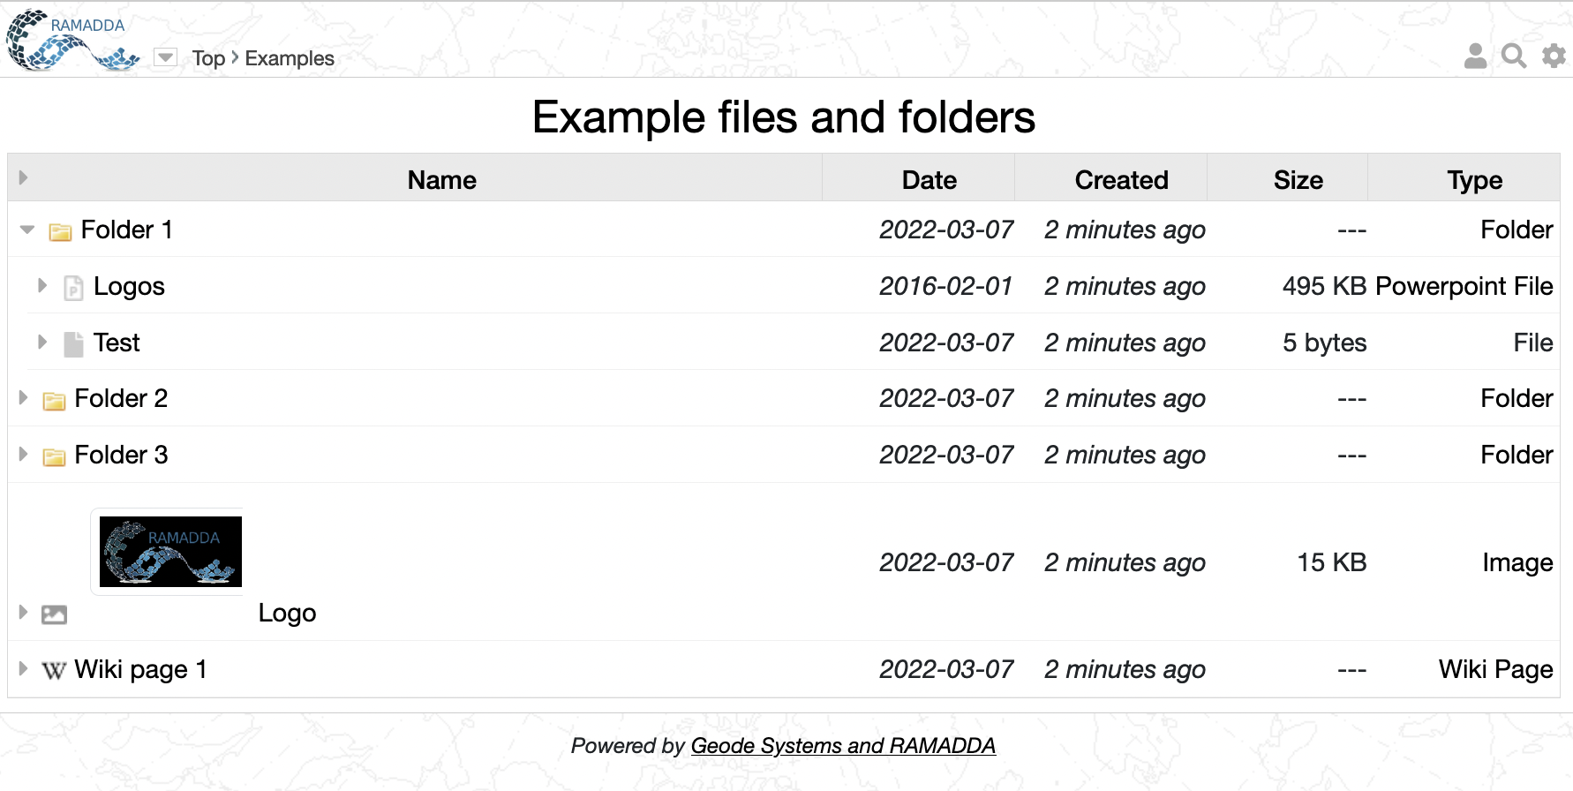
Entry Display
Login, search, settings, help
Breadcrumbs
You are always viewing an entry.
Here it is a folder called “Example files..”
Click on an arrow to open in place
Click on a link to go to that entry
There are folders, files
and other types of entries

Slide 4
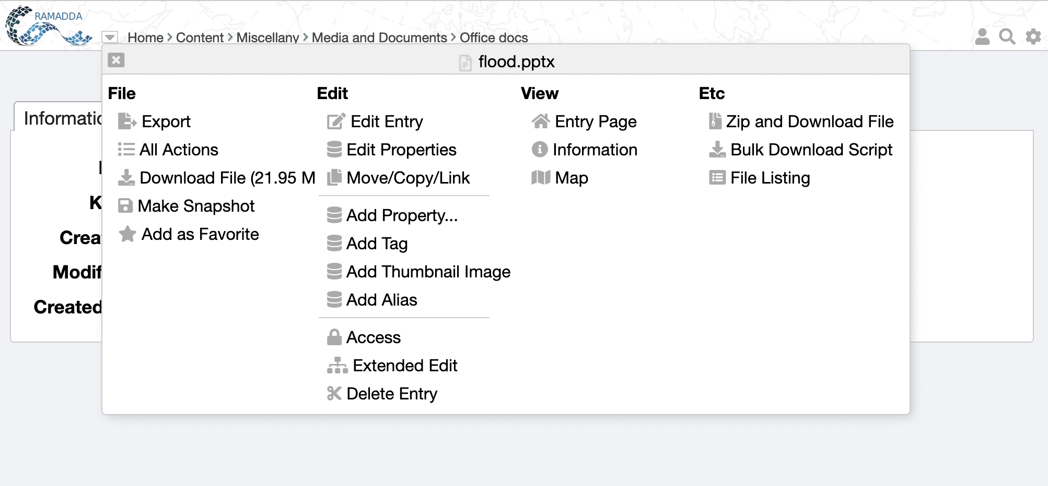
Entry Popup Menu
Popup menu
Information
All actions

Slide 5
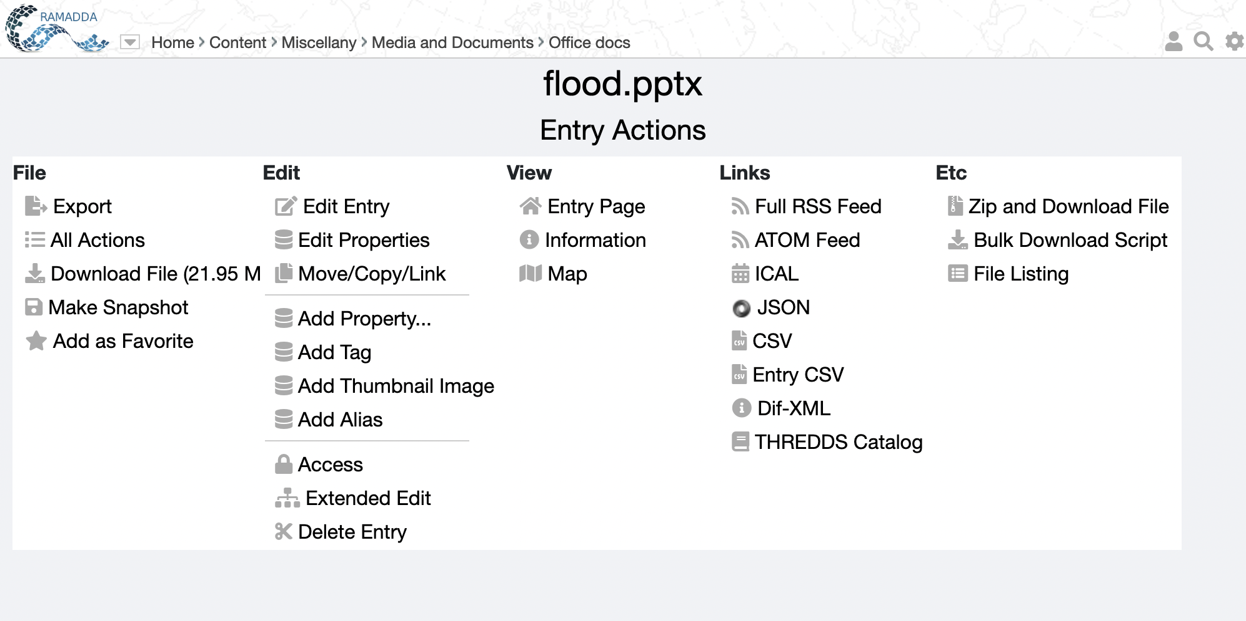
All Actions
All Action
Many ways to view and access an entry

Slide 6
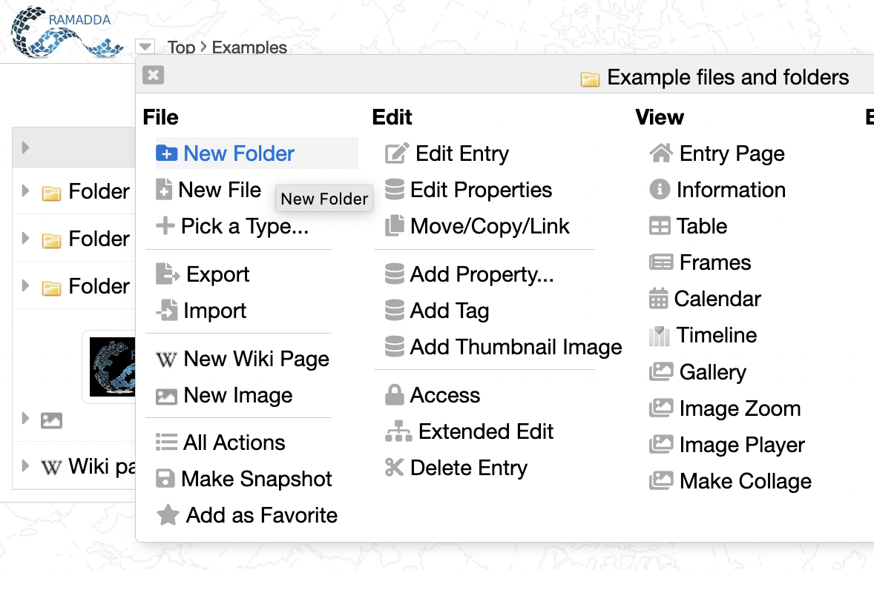
New Folder
Now we’re going to create some content. Login and go to your home entry. Click on the entry popup menu and select “New Folder”

Slide 7
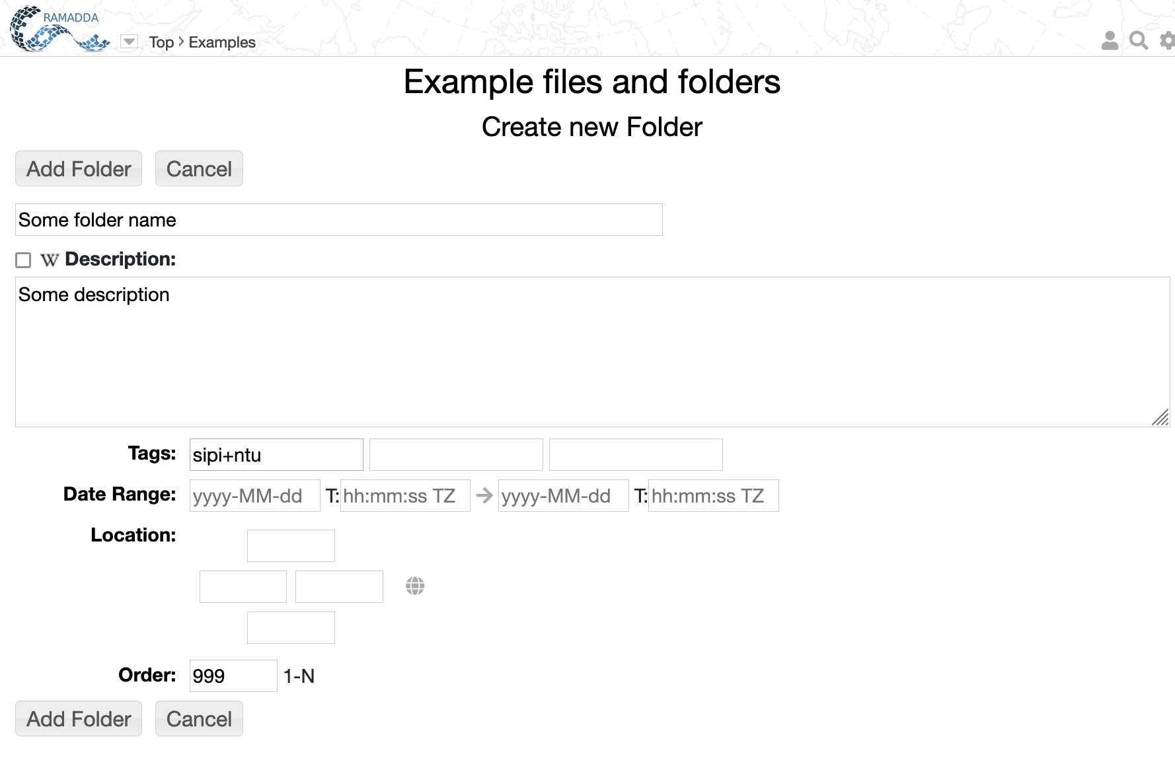
New Folder
Enter a name and some description
You can add multiple tags

Slide 8
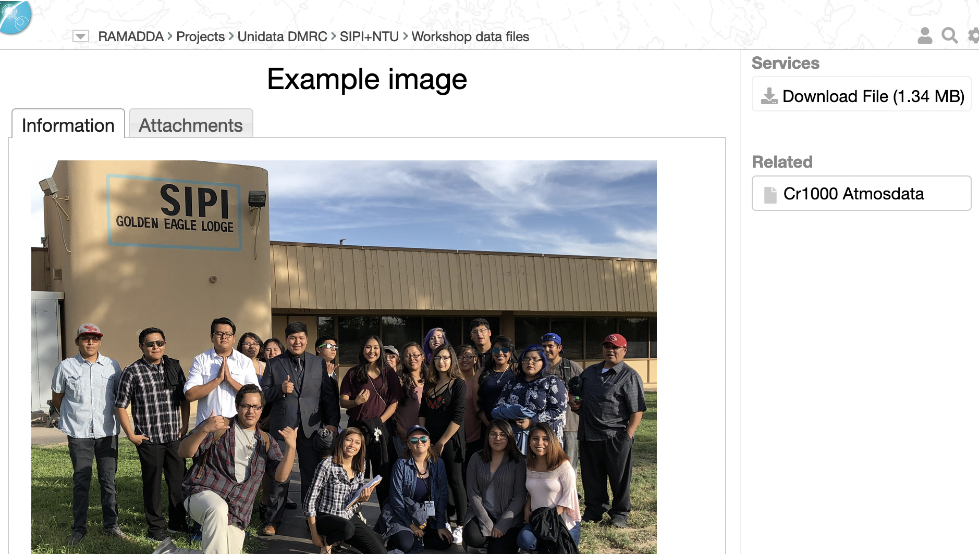
New Files
Now we’re going to upload some files
First – go to the Workshop Data Files ->Example image
And download the image file and save it to disk

Slide 9
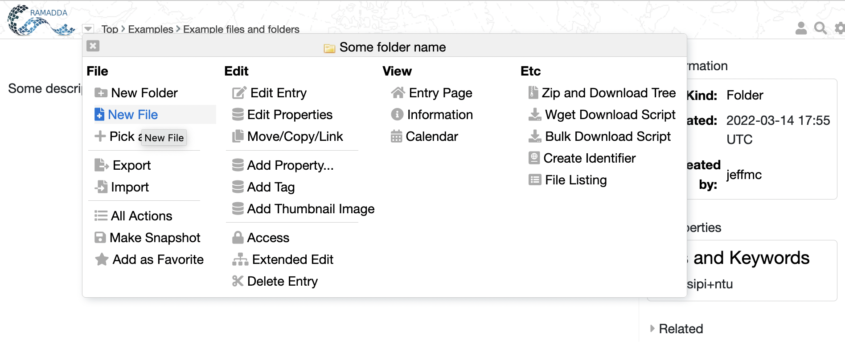
New Files
Now, go back to the new folder entry you just created and click on the entry popup menu and choose New File
Choose New File

Slide 10
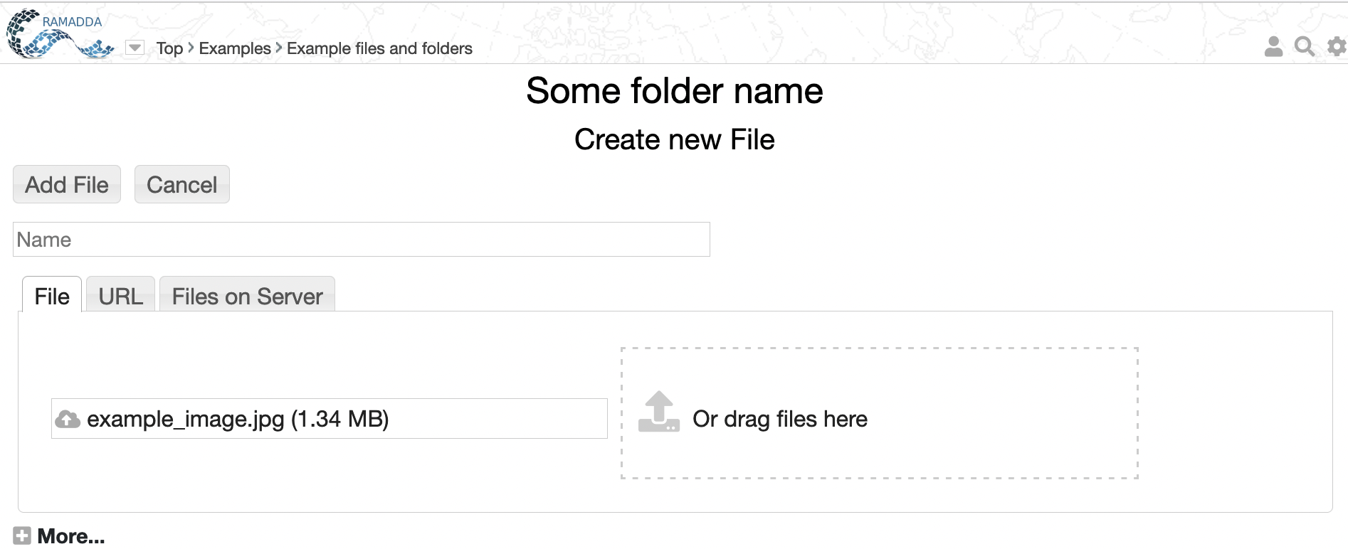
New Files
Select the example image file and press Add File

Slide 11
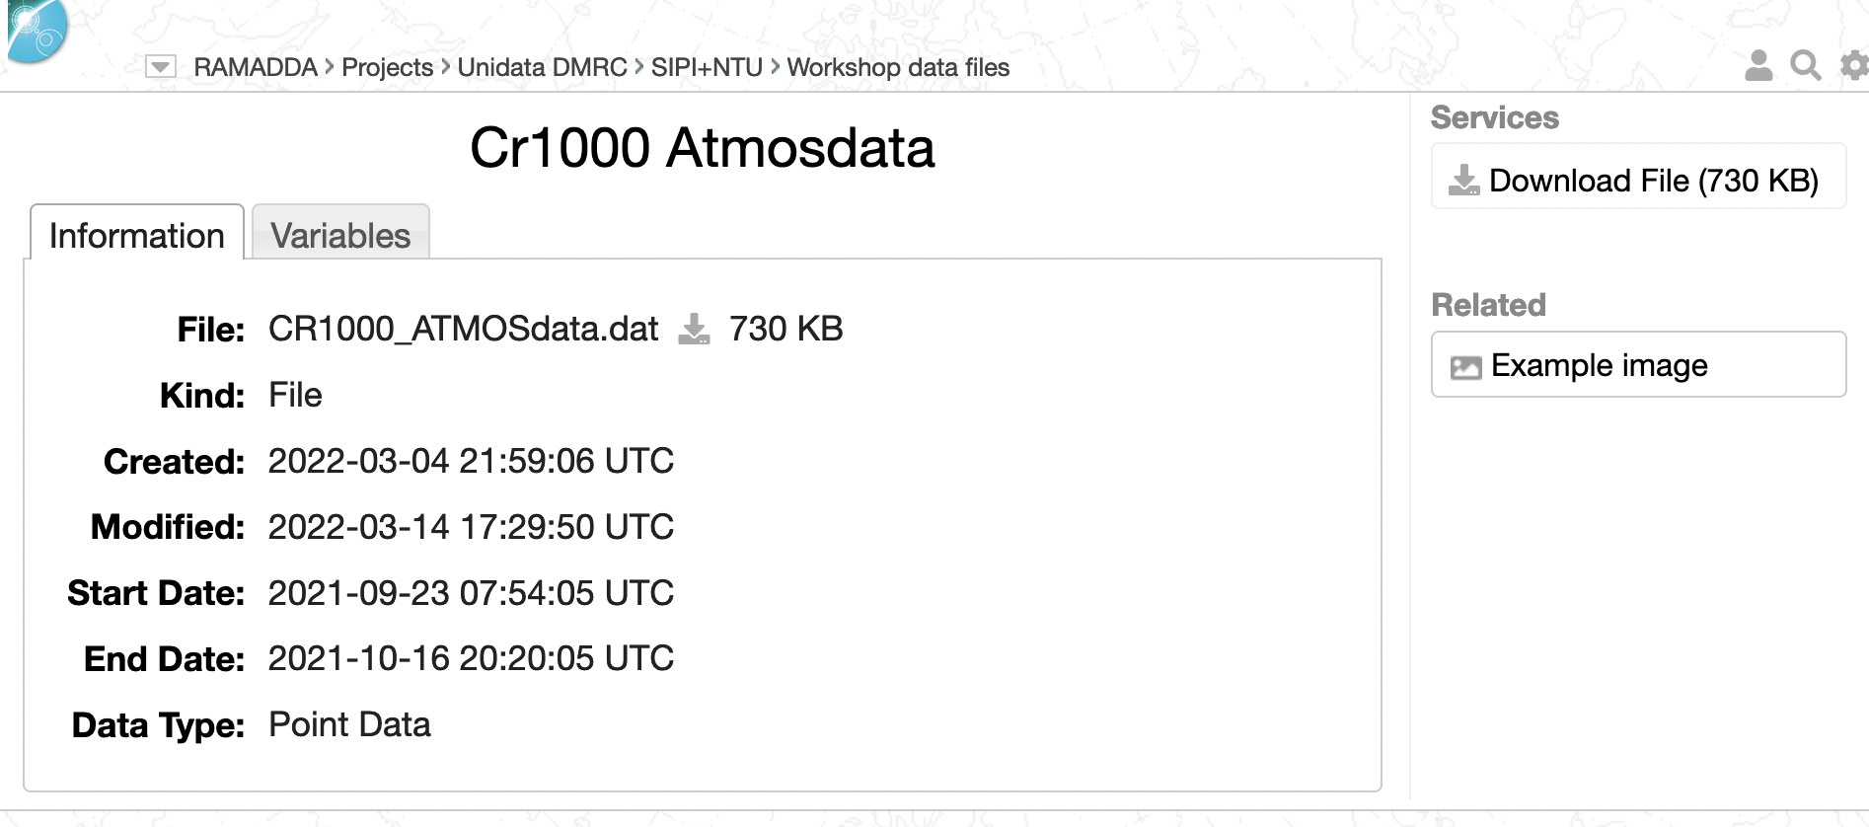
New Files – Specifying the Type
Now we’re going to upload a data file
First – go to the Workshop Data Files ->Cr1000 Atmosdata entry
and download the data file and save it to disk

Slide 12
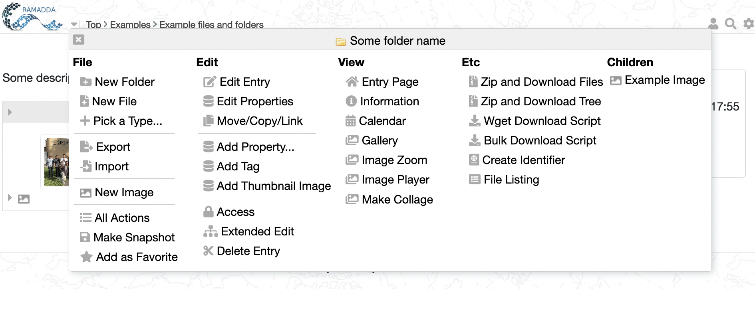
New Files – Specifying the Type
Now go back to your new folder and this time select “Pick a Type…”

Slide 13
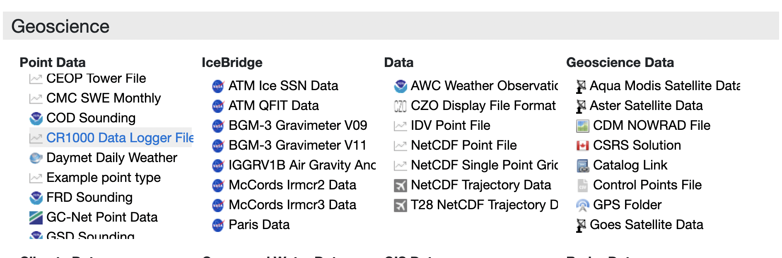
New Files – Specifying the Type
As you can see RAMADDA supports many different entry types.
Under Geoscience->Point Data select CR1000 Data Logger File

Slide 14
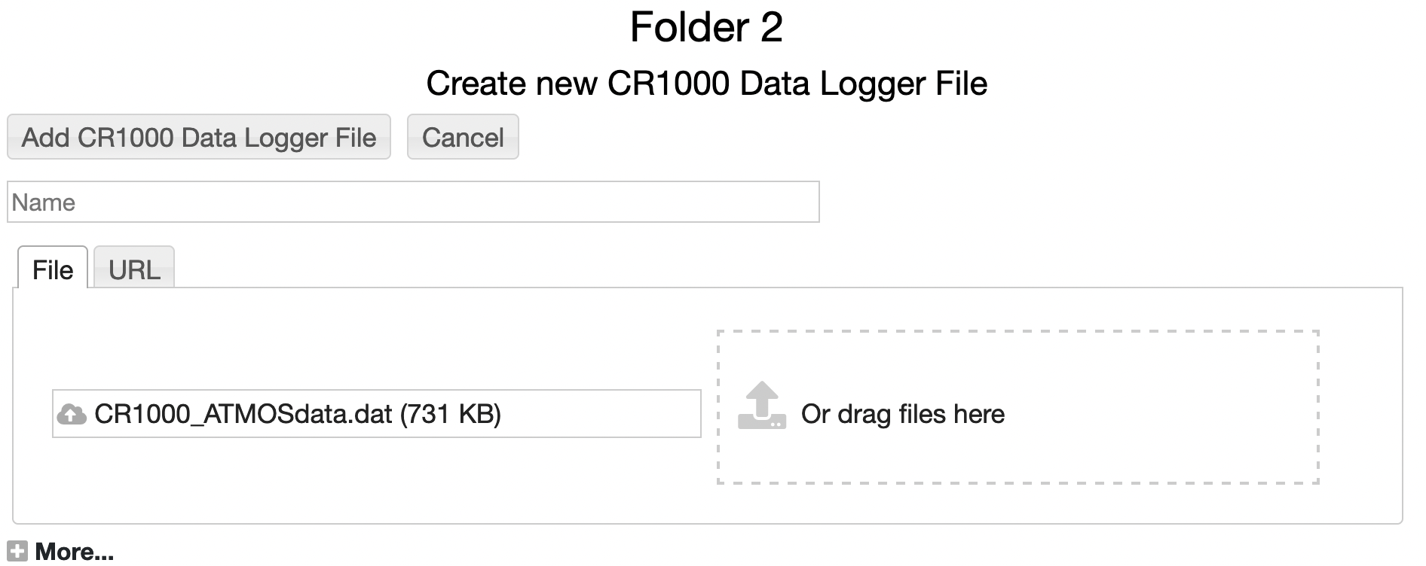
New Files – Specifying the Type
Select the data file you just downloaded and press “Add CR1000 Data Logger File”

Slide 15
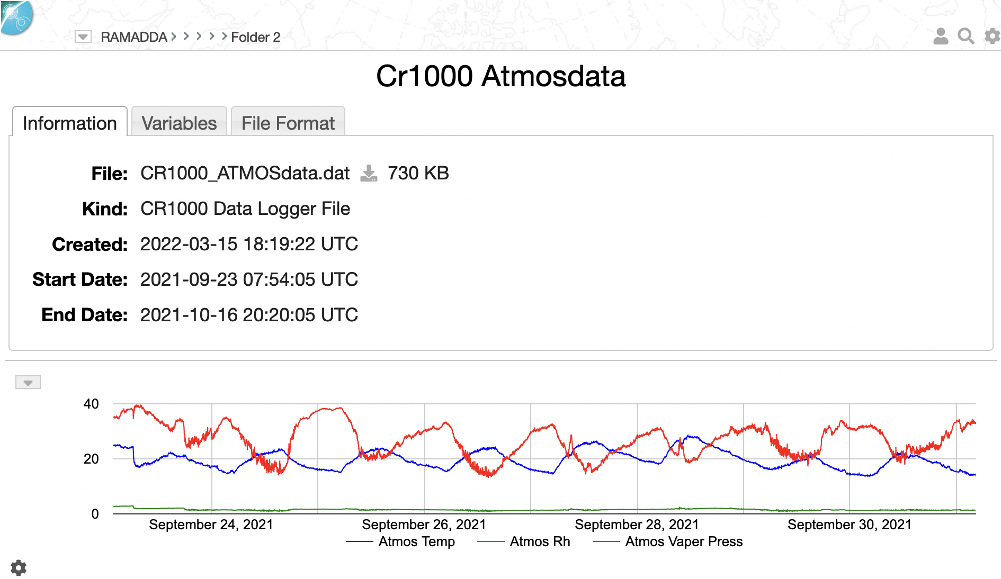
New Files – Specifying the Type
RAMADDA will process the file, extracting temporal and other metadata.
The default view of the CR1000 Data Logger entries is the metadata information and an interactive line chart

Slide 16
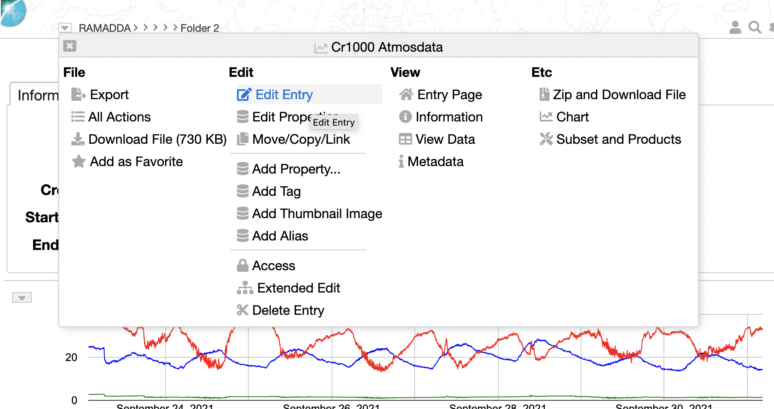
Editing, deleting, etc
Through the entry popup menu you can select Edit Entry, Edit Properties, Add Property, Delete Entry, etc

Slide 17
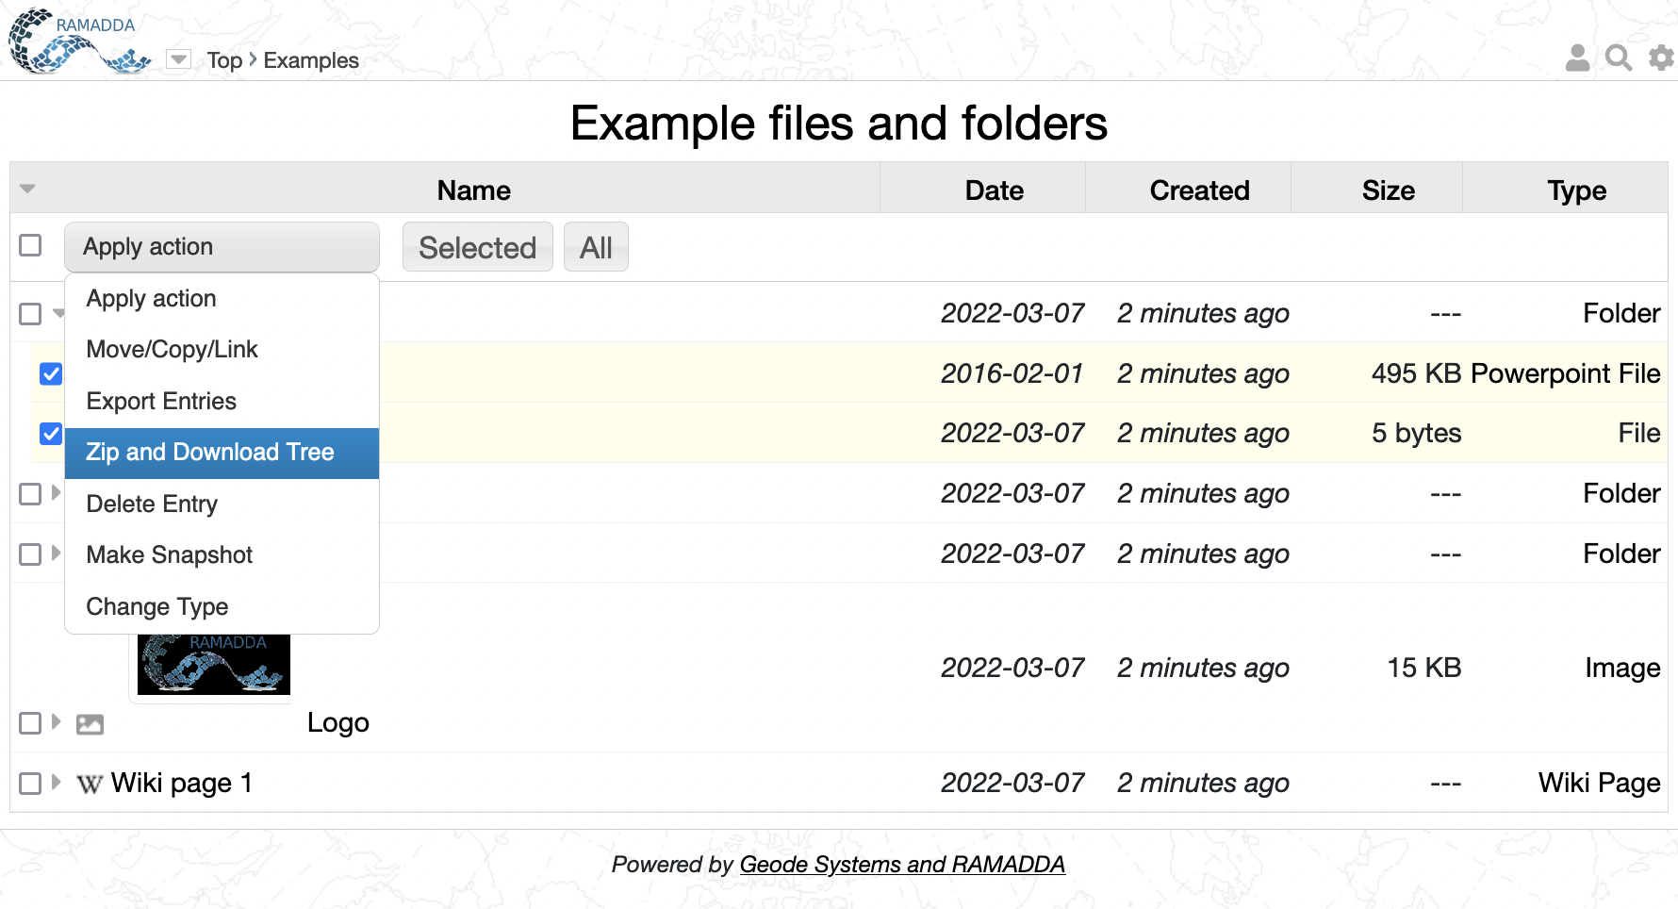
Managing multiple entries
Now we’re going to look at how to manage multiple entries
Toggle form
Select action
Do it
Select entries

Slide 18
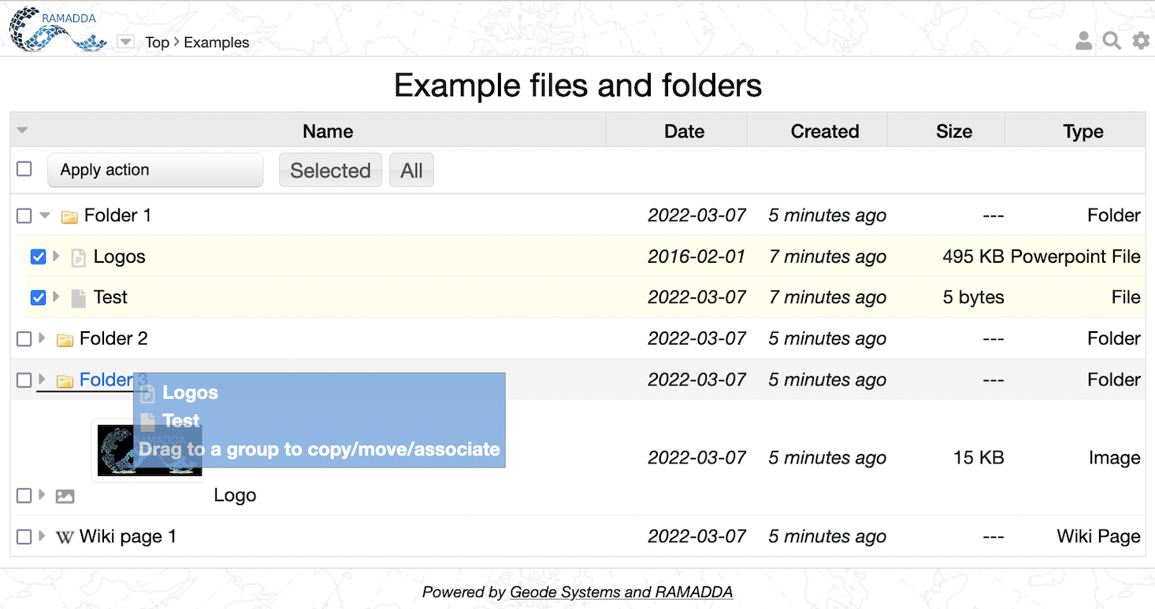
Drag-and-Drop
Click and drag on an icon
Drop it on the destination entry

Slide 19
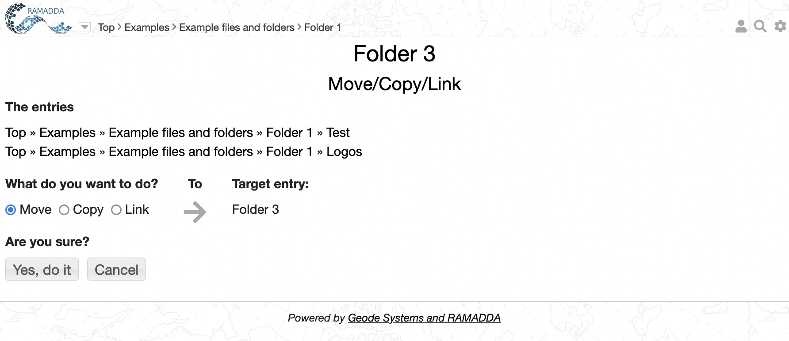
Move/Copy Confirm
Select action

Slide 21
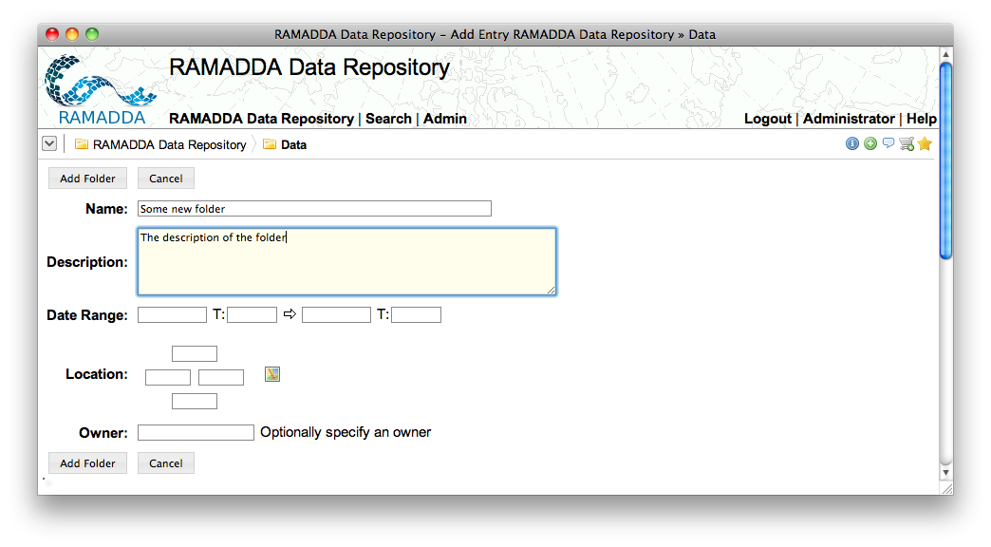

Slide 22
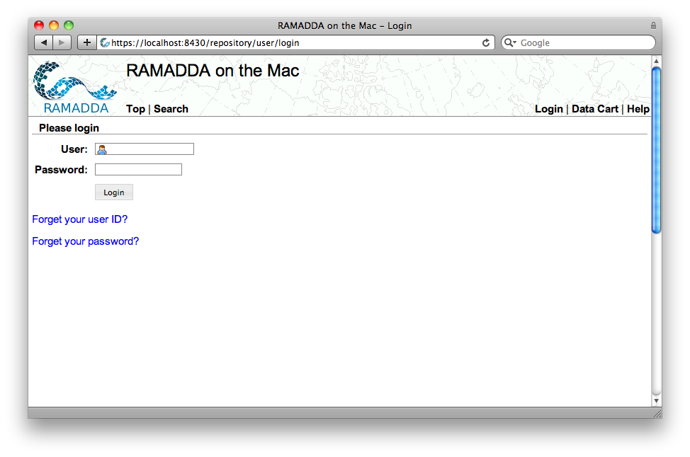
Login link
If the repository has been configured to send email these links will be shown

Slide 23
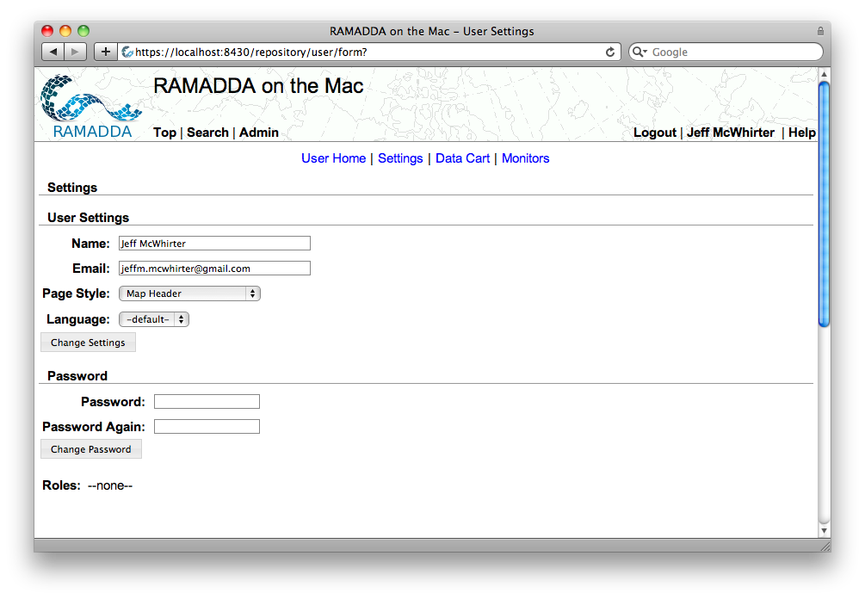
When you are logged in you should see a Logout. You user name takes you to the User Settings page
The User Home link shows all of your “Favorite” entries
Change preferred page style, language, etc

